Slide 1

Yuba River Development Project
FERC Project 2246 Relicensing
Water Balance/Operations Modeling
Wednesday, May 9, 2012

Slide 2
Meeting Objectives
Review previous discussions
  Modeling Approach
Present Model
  Model Validation
  Base Case Scenario
  Yuba River Development Project Model

Slide 3
Model Validation
Evaluation of model logic and hydrology against historical requirements and demands
  Lower Yuba River has been subject to several regulatory conditions over last 10 years
  Yuba River Development Project has operated to meet increasing irrigation demands over the last 10 years
  New Bullards Bar operational approach has changed over last 10 years
  YCWA has conducted multiple transfers in recent years
Conducted detailed evaluation of last 3 years
Conducted high-level evaluation of past 10 years

Slide 4
Model Validation
Considered:
  Our House and Log Cabin dams operations
  New Bullards Bar Reservoir storage
  Flows below New Bullards Bar Reservoir
  Colgate Powerhouse flows
  Narrows 1 and 2 powerhouses releases
  Daguerre Point Dam Deliveries
  Flows at Marysville gage
  Powerhouse generation

Slide 5
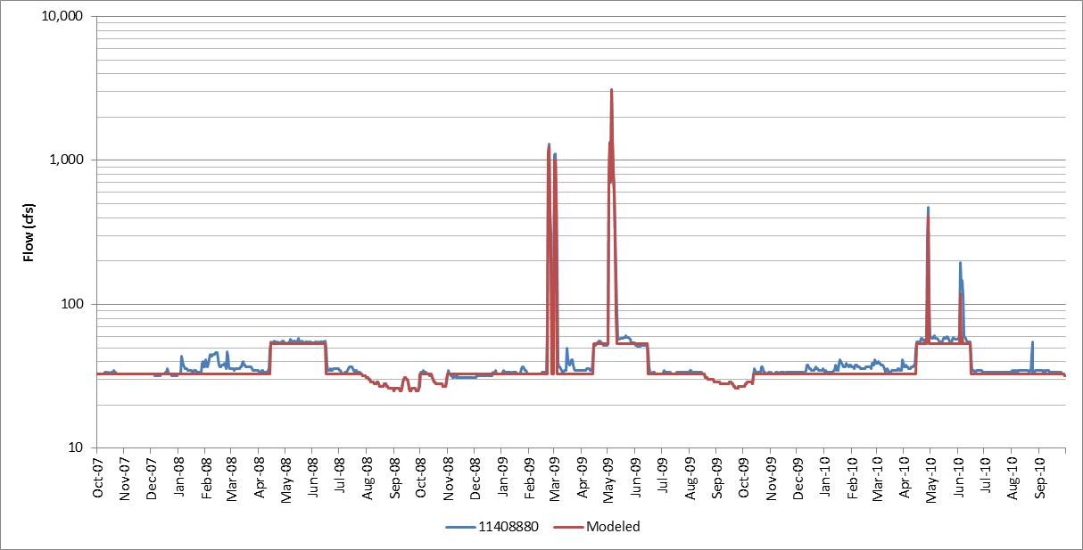
Flow below Our House Dam

Slide 6
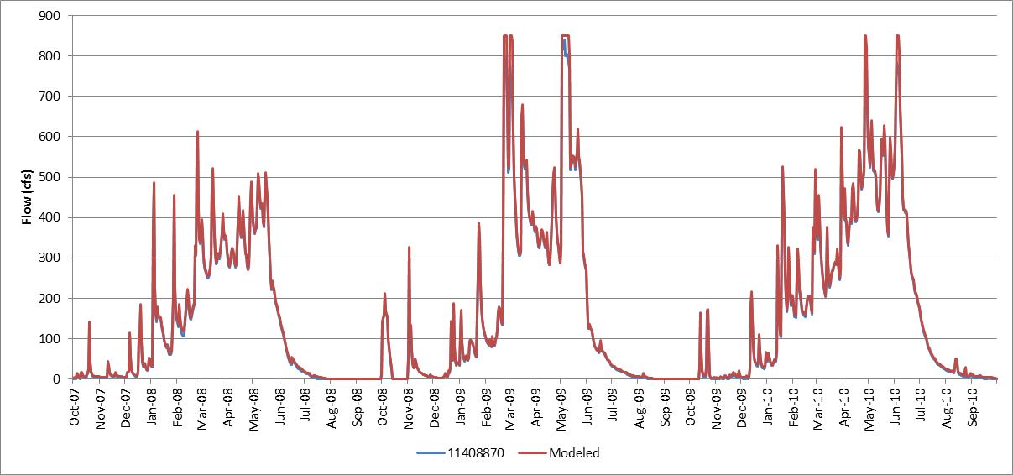
Lohman Ridge Tunnel Flow

Slide 7
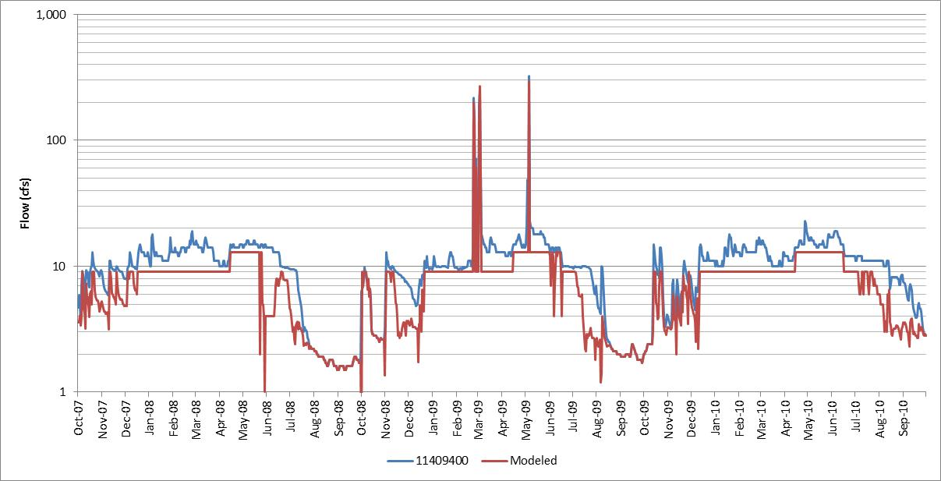
Flow below Log Cabin Dam

Slide 8
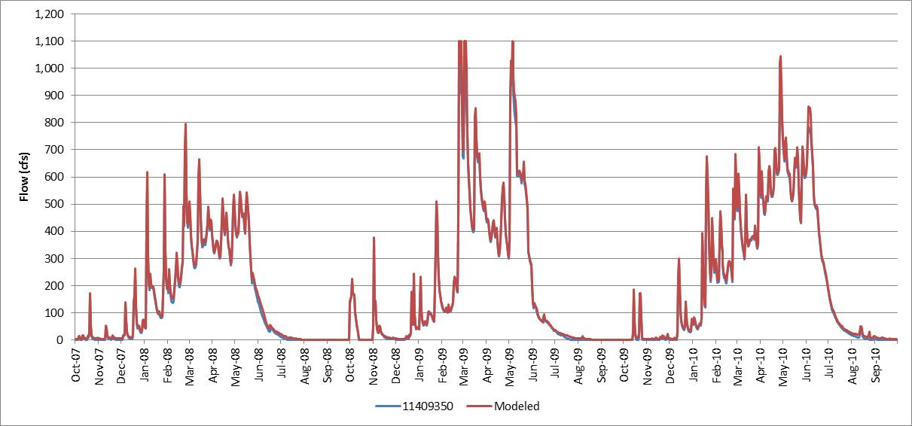
Camptonville Tunnel Flow

Slide 9
Mean Annual Flow at Our House and Log Cabin Dam Gages
Location | Historical |  | Modeled |  | Difference |  | % Difference
 | 3 Year | 10 Year | 3 Year | 10 Year | 3 Year | 10 Year | 3 Year | 10 Year
11408880 | 52.0 | 99.6 | 48.5 | 79.2 | 3.5 | 20.4 | 7% | 21%
11408870 | 159.4 | 165.5 | 163.0 | 185.9 | (3.5) | (20.4) | -2% | -12%
11409400 | 11.2 | 15.7 | 8.3 | 12.2 | 2.9 | 3.5 | 26% | 22%
11409350 | 189.4 | 204.9 | 196.0 | 229.3 | (6.6) | (24.4) | -3% | -12%

Slide 10
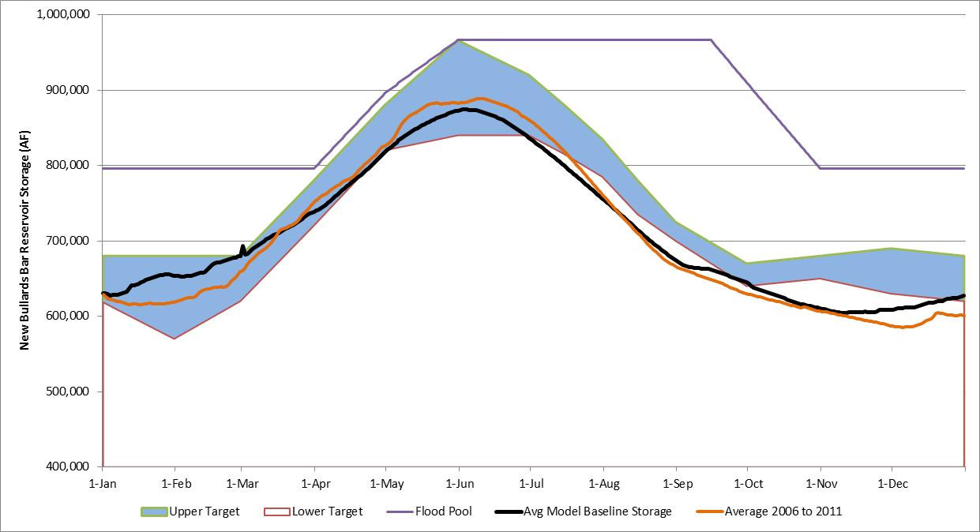
New Bullards Bar Reservoir Target Storage

Slide 11
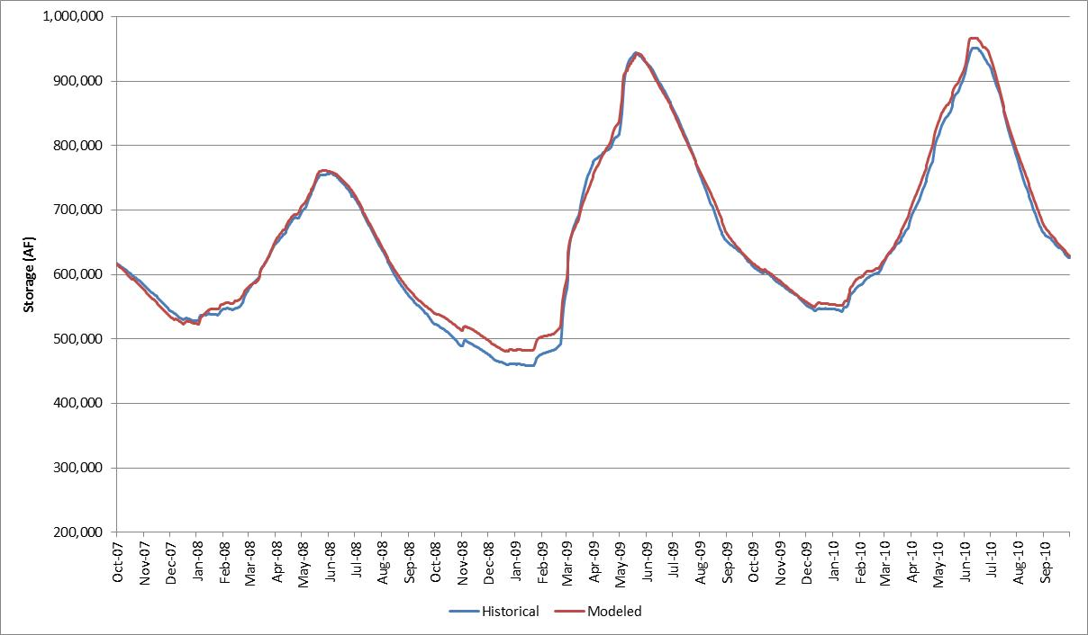
New Bullards Bar Reservoir Storage
3-Year Validation

Slide 12
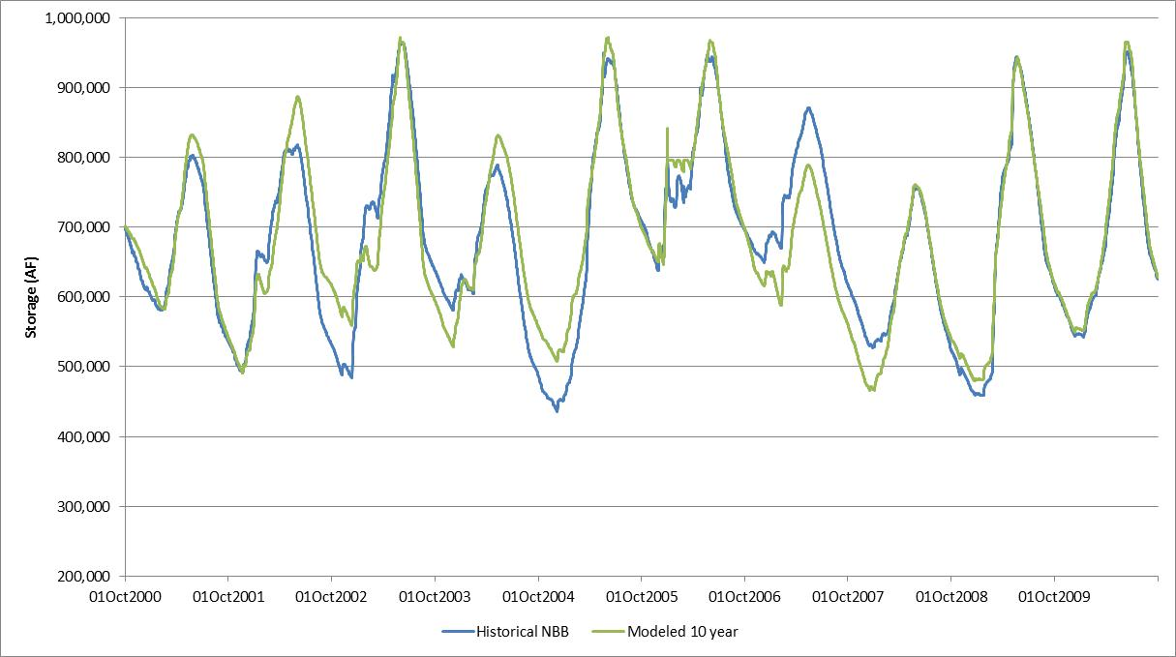
New Bullards Bar Reservoir Storage
10-Year Validation

Slide 13
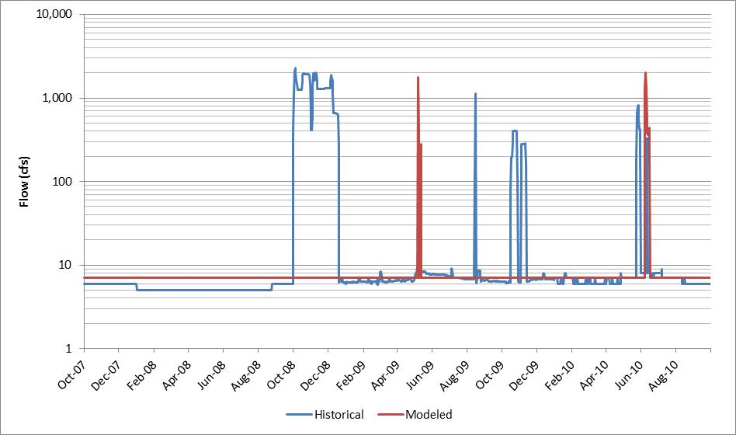
Flow below New Bullards Bar Dam

Slide 14
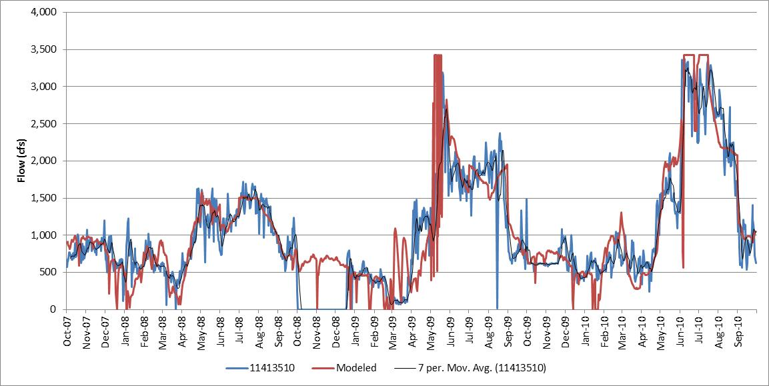
Colgate Powerhouse Releases

Slide 15
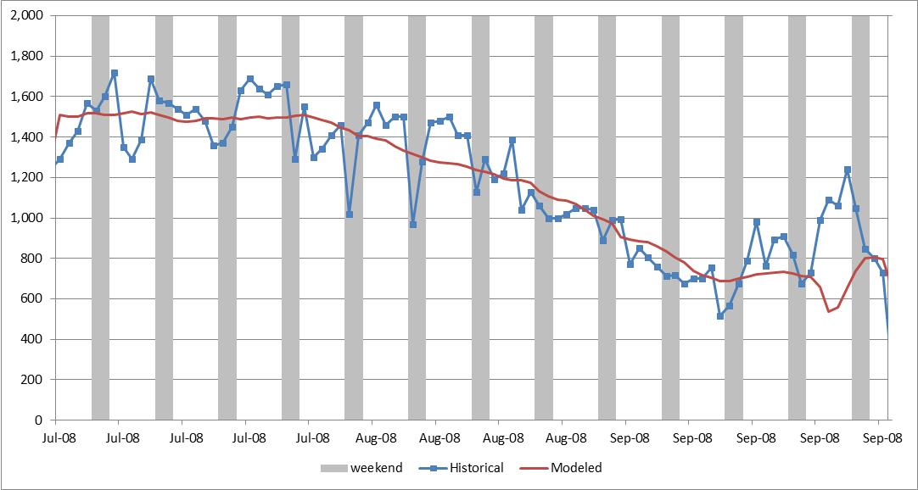
Colgate Powerhouse Releases
Summer of 2008 with weekends shaded

Slide 16
Mean Annual Colgate Powerhouse Release
Location | Historical |  | Modeled |  | Difference |  | % Difference
 | 3 Year | 10 Year | 3 Year | 10 Year | 3 Year | 10 Year | 3 Year | 10 Year
11413510 | 1,011.2 | 1,206.4 | 1,069.0 | 1,250.2 | (57.8) | (43.8) | -6% | -4%
1141350 plus Low Outlet | 1,060.0 | 1,221.0 | 1,069.0 | 1,250.2 | (9.0) | (29.1) | -1% | -2%

Slide 17
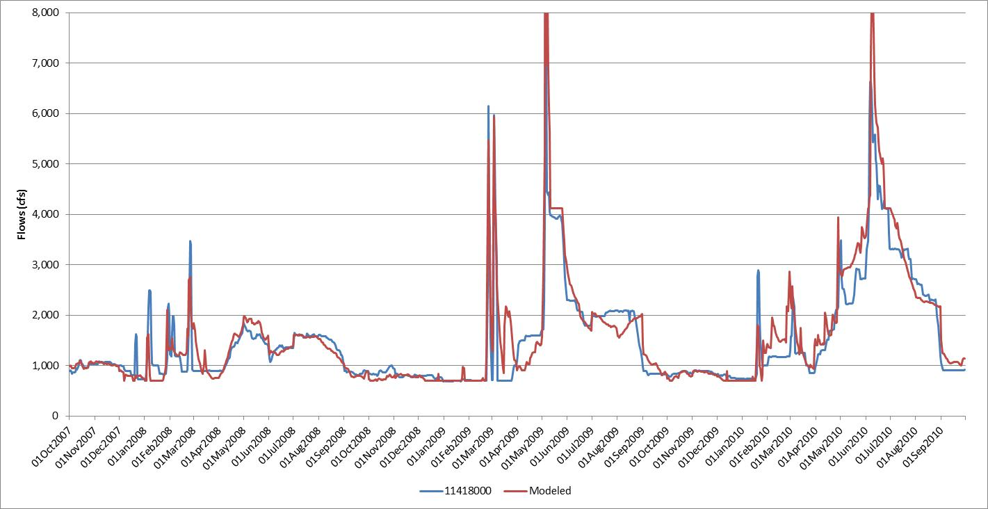
Flow below Englebright Dam
3-Year Validation

Slide 18
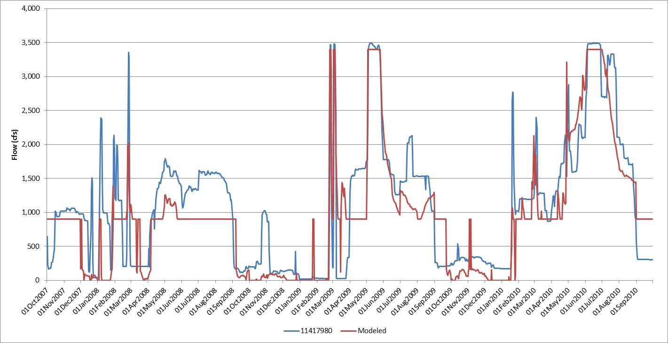
Narrows 2 Powerhouse Releases
3-Year Validation

Slide 19
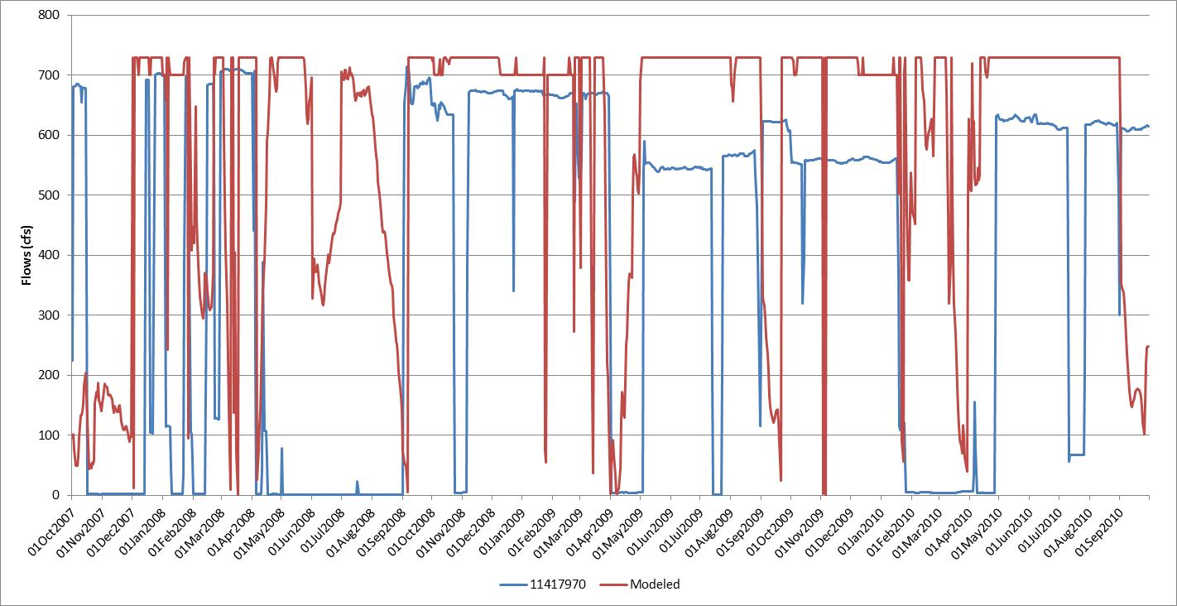
Narrows 1 Powerhouse Releases
3-Year Validation

Slide 20
Mean Annual Flow Below Englebright Dam
Location | Historical |  | Modeled |  | Difference |  | % Difference
 | 3 Year | 10 Year | 3 Year | 10 Year | 3 Year | 10 Year | 3 Year | 10 Year
11408880 | 1,496.5 | 1,937.9 | 1,551.4 | 1,991.8 | (54.9) | (53.9) | -4% | -3%
(water year 20007 data not available from USGS - YCWA records used)
11417980 | 1,090.6 | 1,372.8 | 919.4 | 1,077.8 | 171.2 | 295.0 | 16% | 21%
11417970 | 378.8 | 258.2 | 586.5 | 611.6 | (207.7) | (353.4) | -55% | -137%

Slide 21
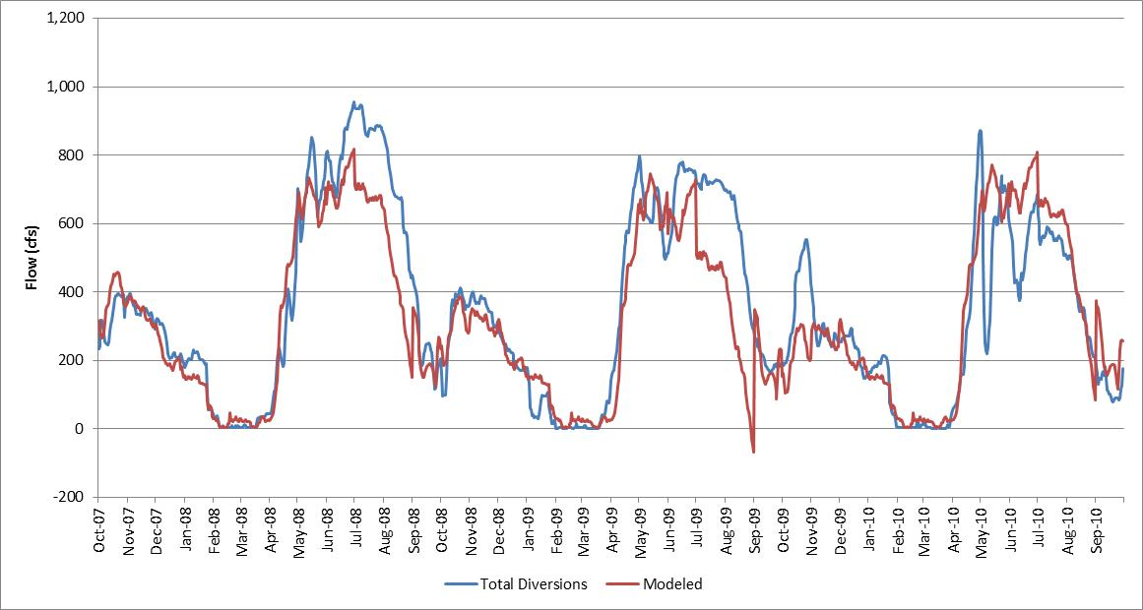
Daguerre Point Dam Deliveries

Slide 22
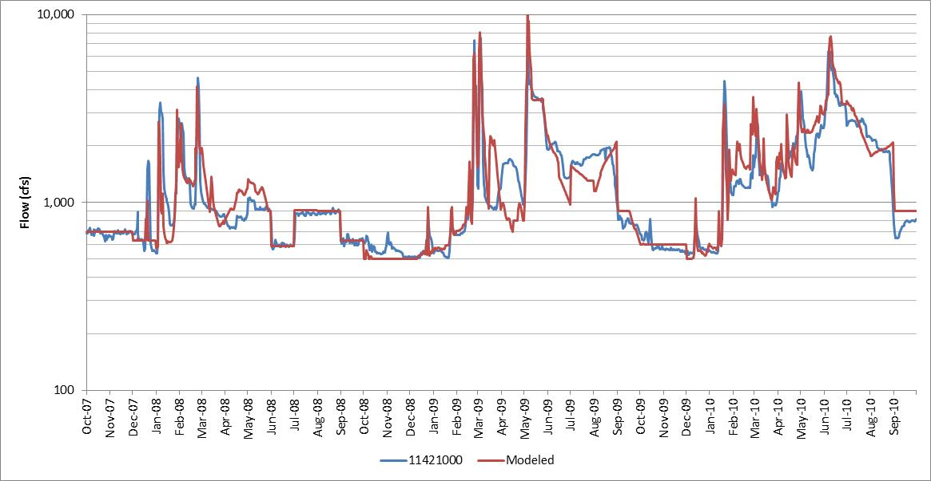
Flow at Marysville Gage

Slide 23
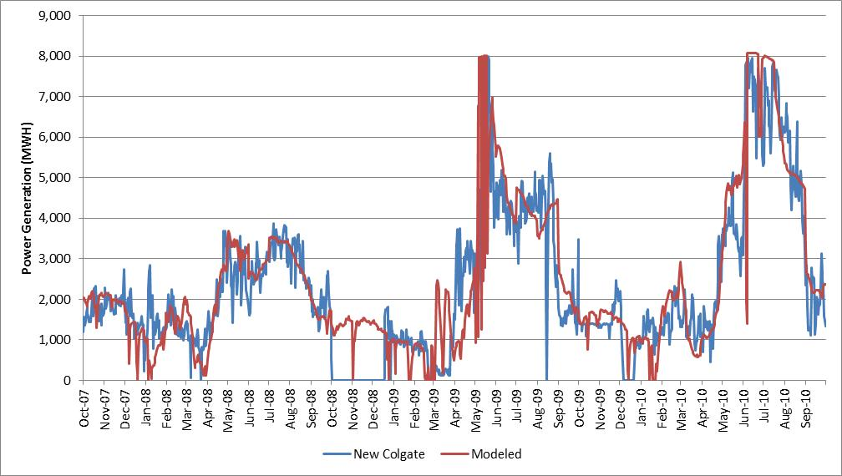
Colgate Powerhouse Generation

Slide 24
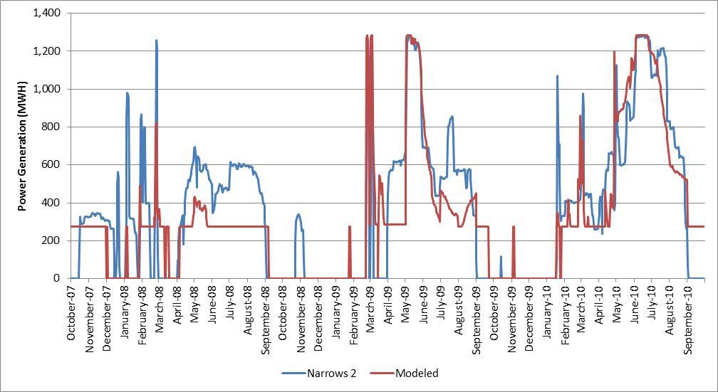
Narrows 2 Powerhouse Generation

Slide 25
Mean Annual Generation
Location | Historical |  | Modeled |  | Difference |  | % Difference
 | 3 Year | 10 Year | 3 Year | 10 Year | 3 Year | 10 Year | 3 Year | 10 Year
Colgate | 2,303.5 | 2,806.8 | 2,466.2 | 2,858.6 | (162.7) | (51.8) | -7% | -2%
Narrows 2 | 369.0 | 507.9 | 317.4 | 376.0 | 51.6 | 131.8 | 14% | 26%

Slide 26
Base Case Scenario
Handout

Slide 27
Yuba River Development Project Model
Version 1.1 on CD
  YRDP Model v1.1.xlsm
  YRDPM Input Hydrology 20120530.dss
  YRDPM Validation Input Hydrology 2001-2010 20120516.dss
  YRDP Validation Output.dss
  YRDPM v1.1 Base Case 20120614.dss
  Operations Modeling Assumptions 20120614.pdf
  Hydrology Report 20120614.docx
  Validation Report 20120614.docx
  HEC-DSS_Excel_Data_Exchange_Add-In_For_Excel_2007-2010_v321.exe

